Slide 1
Accreditation and Curriculum Development
Stacy Hutchinson, Ph.D
Biological and Agricultural Engineering
Kansas State University
Manhattan, KS 66502

Slide 2
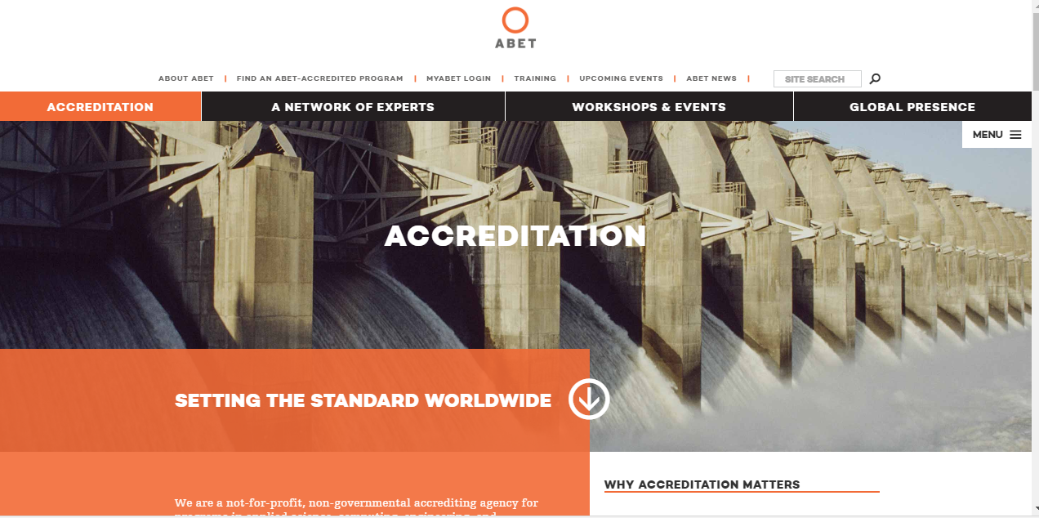
http://www.abet.org/

Slide 3
Accreditation
Accreditation Board for Engineering and Technology:
a nonprofit, non-governmental organization recognized by the Council for Higher Education Accreditation (CHEA).
accredits college and university programs in the disciplines of applied science, computing, engineering, and engineering technology at the associate, bachelor, and master degree levels.
30 Countries– Austria, Kazakhstan, Russia, Spain, Turkey

Slide 4
Accreditation
Engineering programs are accredited on a 6 year cycle.
Engineers must graduate from an ABET accredited program in order to qualify for licensure in U.S.
Different engineering degree programs are governed by their respective professional societies

Slide 5
Accreditation
GENERAL CRITERIA FOR BACCALAUREATE LEVEL PROGRAMS
Criterion 1. Students
Criterion 2. Program Educational Objectives
Criterion 3. Student Outcomes
Criterion 4. Continuous Improvement
Criterion 5. Curriculum
Criterion 6. Faculty
Criterion 7. Facilities
Criterion 8. Institutional Support

Slide 6
Accreditation
GENERAL CRITERION 5. CURRICULUM
The curriculum requirements specify subject areas appropriate to engineering but do not prescribe specific courses. The faculty must ensure that the program curriculum devotes adequate attention and time to each component, consistent with the outcomes and objectives of the program and institution. The professional component must include:
(a) one year of a combination of college level mathematics and basic sciences (some with experimental experience) appropriate to the discipline. Basic sciences are defined as biological, chemical, and physical sciences.
1 year is 32 credit hours or 25% of total degree program credits

Slide 7
Accreditation
GENERAL CRITERION 5. CURRICULUM
(b) one and one-half years of engineering topics, consisting of engineering sciences and engineering design appropriate to the student’s field of study. The engineering sciences have their roots in mathematics and basic sciences but carry knowledge further toward creative application. These studies provide a bridge between mathematics and basic sciences on the one hand and engineering practice on the other. Engineering design is the process of devising a system, component, or process to meet desired needs. It is a decision-making process (often iterative), in which the basic sciences, mathematics, and the engineering sciences are applied to convert resources optimally to meet these stated needs.

Slide 8
Accreditation
GENERAL CRITERION 5. CURRICULUM
(c) a general education component that complements the technical content of the curriculum and is consistent with the program and institution objectives.
Students must be prepared for engineering practice through a curriculum culminating in a major design experience based on the knowledge and skills acquired in earlier course work and incorporating appropriate engineering standards and multiple realistic constraints.

Slide 9
Accreditation
III. PROGRAM CRITERIA
Each program must satisfy applicable Program Criteria (if any). Program Criteria provide the specificity needed for interpretation of the general criteria as applicable to a given discipline. Requirements stipulated in the Program Criteria are limited to the areas of curricular topics and faculty qualifications. If a program, by virtue of its title, becomes subject to two or more sets of Program Criteria, then that program must satisfy each set of Program Criteria; however, overlapping requirements need to be satisfied only once.

Slide 10
Accreditation

Slide 11
Curriculum
Curriculum Chart
Flowchart
Assessment Tables

Slide 12
I do not believe that it is my responsibility to fill you with knowledge (i.e. pouring water into a glass), but rather to give you the desire and tools to acquire more knowledge on your own (i.e. fanning a fire).
Philosophy

